Slide 1
LEELA LAVANYA GANTA
EMPLOYEE ID: 152987
JAVA FULL STACK, MIPL
TEAM-7

Slide 2
CapStore Shopping Application

Slide 3
Project Requirements

Slide 4
Softwares:
Java 10
STS Version: 3.9.4.RELEASE
Bootstrap
MySQL 5.5 Command Line Client
HTML 5
CSS 3
JavaScript
JSP
Spring Boot (2.0.4)
Spring Rest
Notes:
Fixar a posicao do titulo – sempre do lado esquerdo.
Sempre que tiver muito texto o coluna deve sempre ser “ narrowed” , se nao fica dificil de ler. Colocar paragrafos no texto.
Linha vertical deve ser mais fina e as pontas NUNCA devem ser arredondadas.

Slide 5
APPLY DISCOUNTS AND APPLY COUPONS

Slide 6
APPLY DISCOUNTS
Fetching the details from the database and calculate the price and applying the discount for products.
Calculate the discount percentage and show the new price in product page

Slide 7
APPLY COUPONS
Fetching the details from the database and calculate the price and applying the coupons to the customers
Calculate the coupon amount and show the new price in payment page

Slide 8
Tables Used
Inventory
productId
category
dateOfInclusion
description
expiryDate
noOfViews
Price
productName
quantity
brandId
couponId
discountId
invoiceProductId
merchantId
Discount
discountId
discountpercent
expirydate
issuedate
productId
promoamount
promoname

Slide 9
Tables Used
Inventory
productId
category
dateOfInclusion
description
expiryDate
noOfViews
Price
productName
quantity
brandId
couponId
discountId
invoiceProductId
merchantId
Coupons
couponId
couponamount
couponcode
coupondescription
productId
issuedate
expirydate

Slide 10
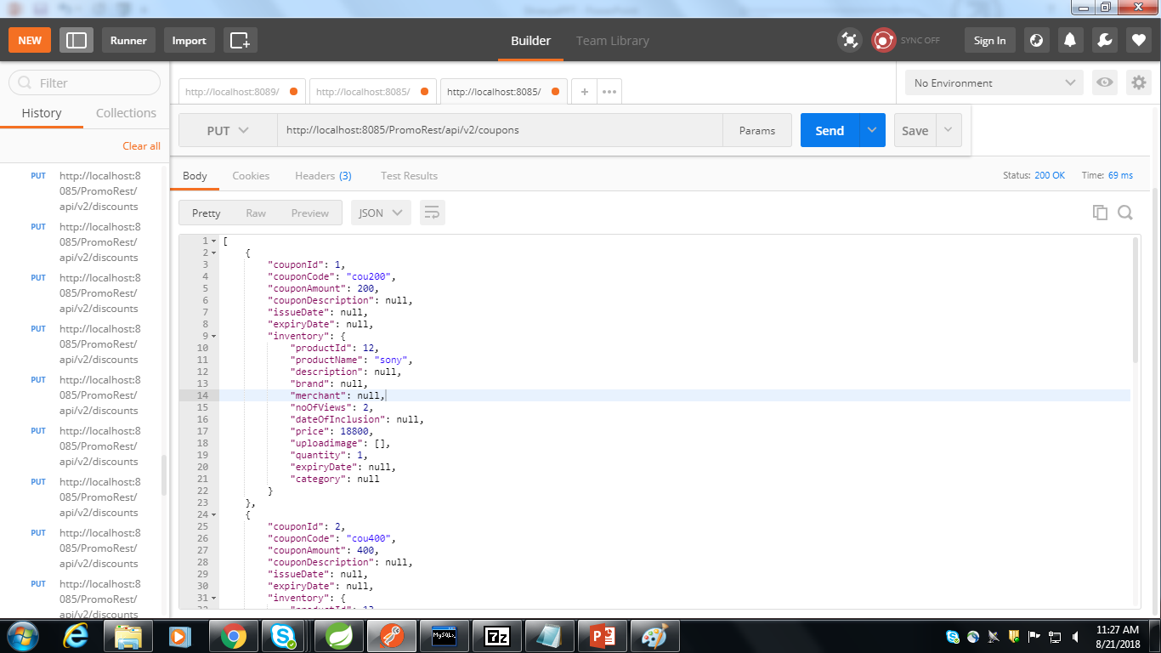

Slide 11
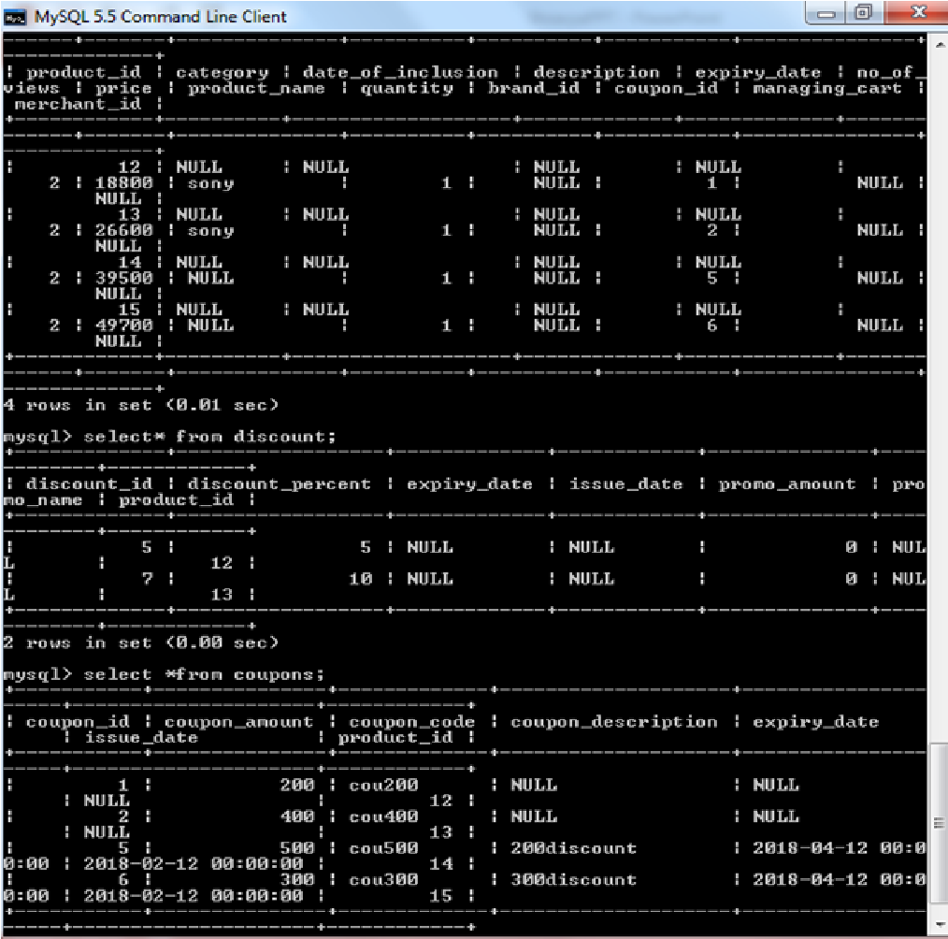

Slide 12


Slide 13
Thank You
Notes:
O Box atras do texto desnecessario. Deixar o layout mais simples.

